Slide 1

Sync-Care
By: August DeWinkler, Genesi Gonzalez, Nicholas Gamarra, David Gibson and Nicholas Angiolilli

Slide 2
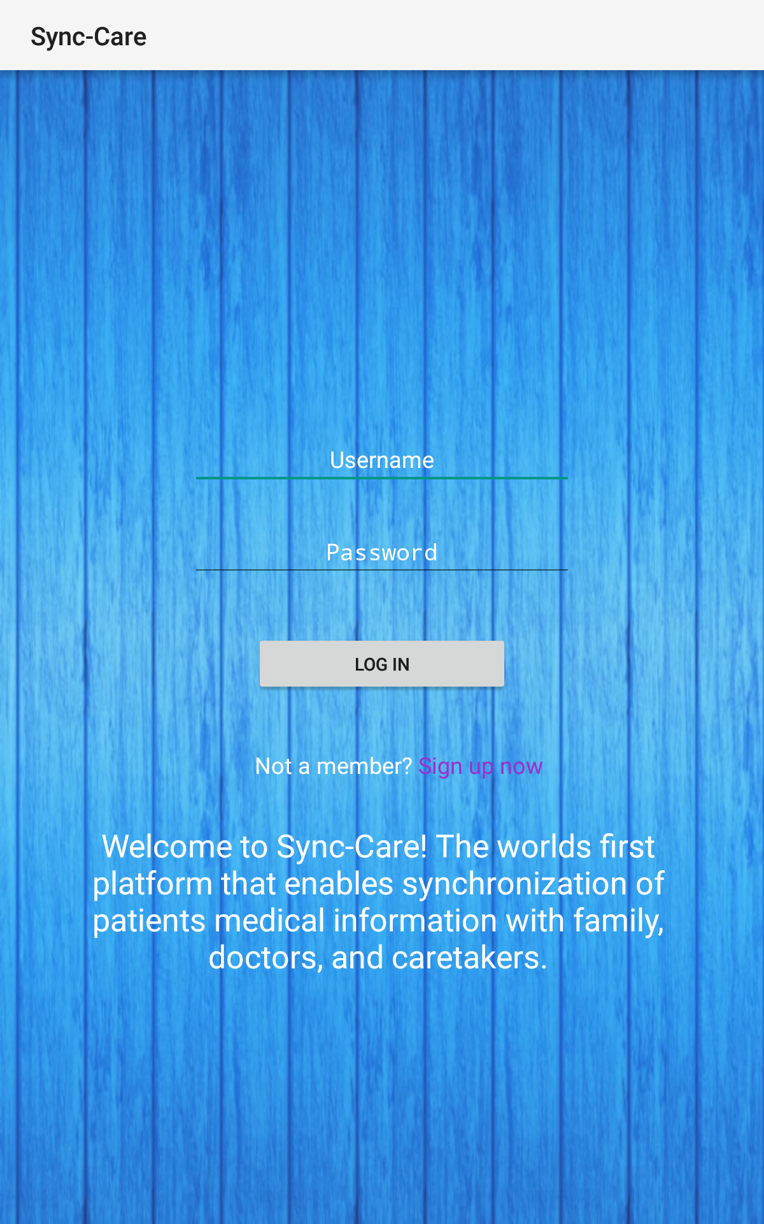
Log In Page
Here is our log in and sign up page for the app, as well as a brief introduction into what our app accomplishes.
We have a logo but we are in the process of redesigning it so we have yet to implement it.

Slide 3
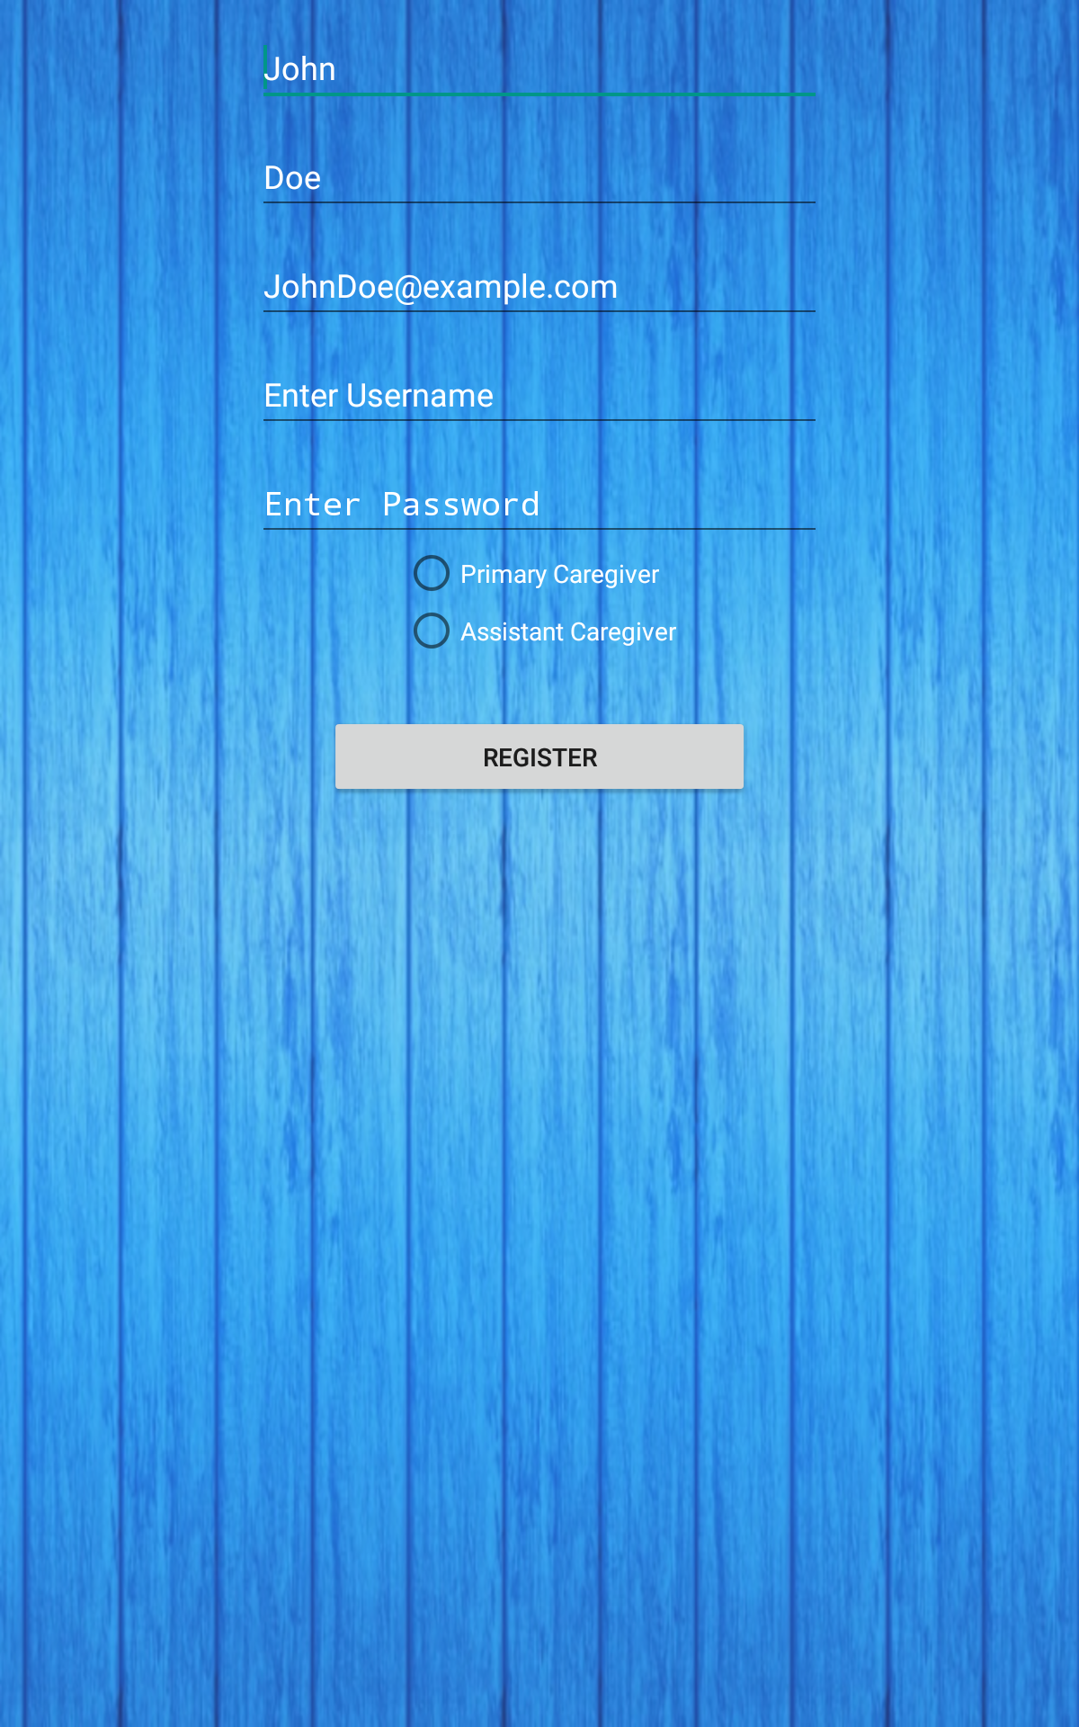
Sign Up Page
Here is our sign up page where the information needed is a first and last name, email for verification, and a username and password. You also have to select whether you are the primary caregiver of a patient(s) or an assistant caregiver.

Slide 4
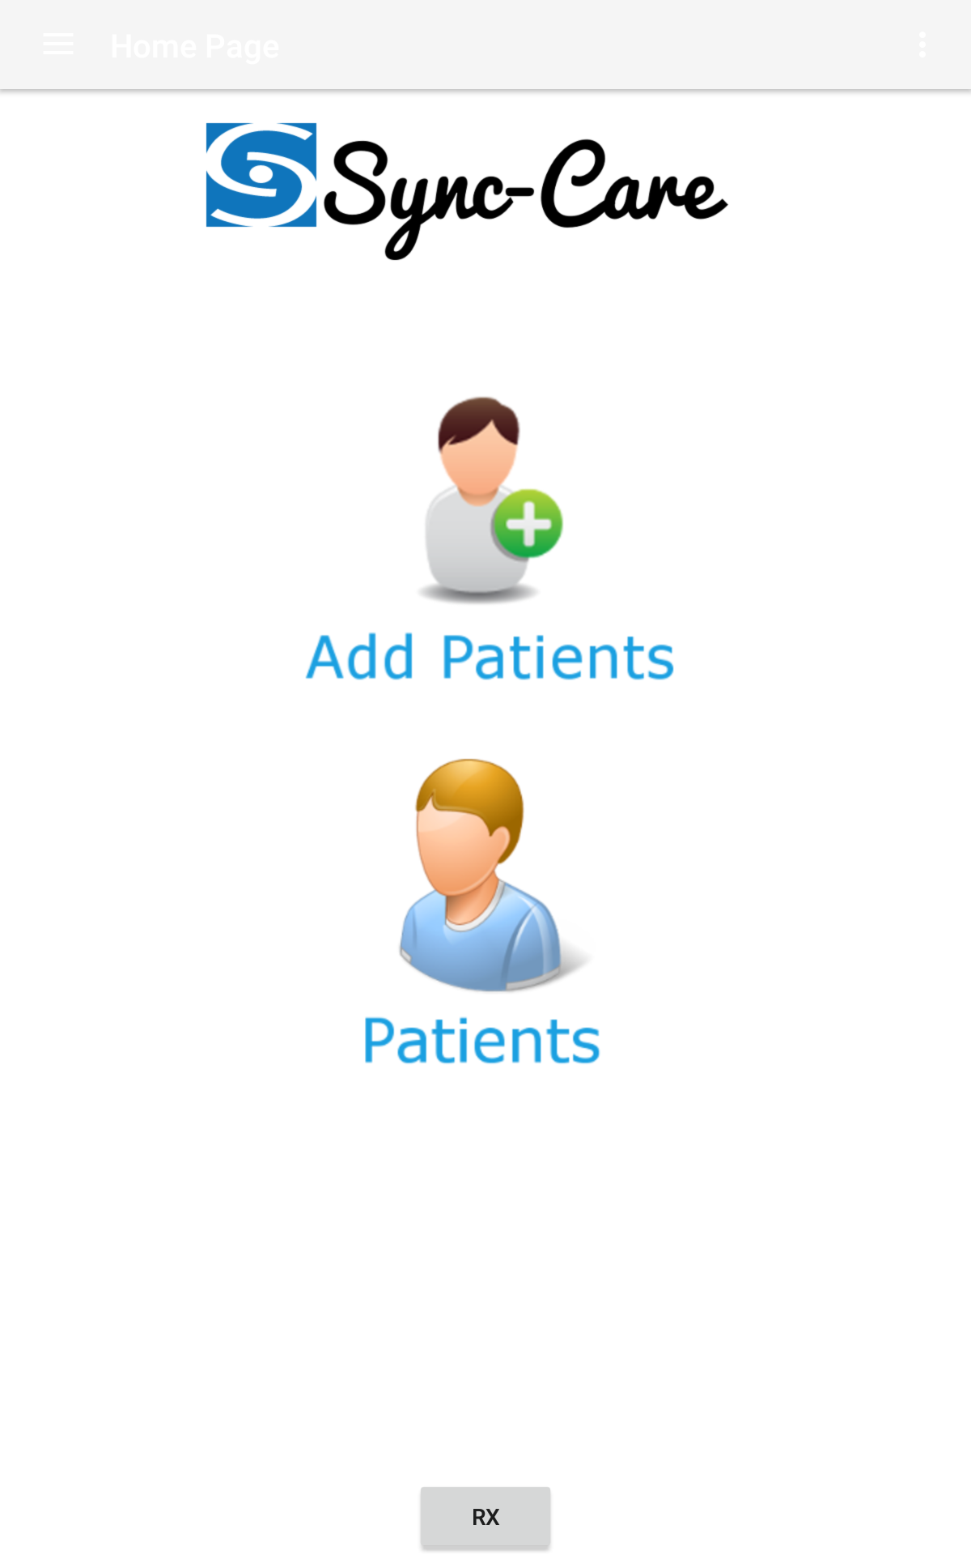
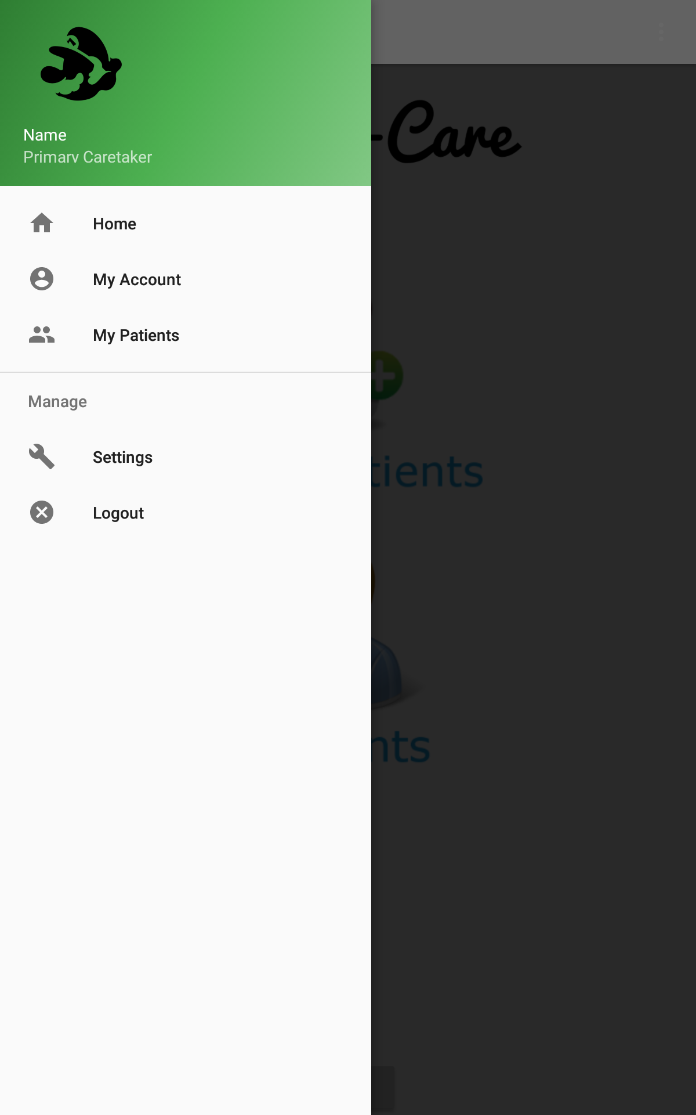
Home Page
Here is our home page after you log in where you are able to add a patient. On the left is our current display but we are going to change it up to having a navigation drawer as seen to the right. Page on the left will be relegated to a logo screen.

Slide 5
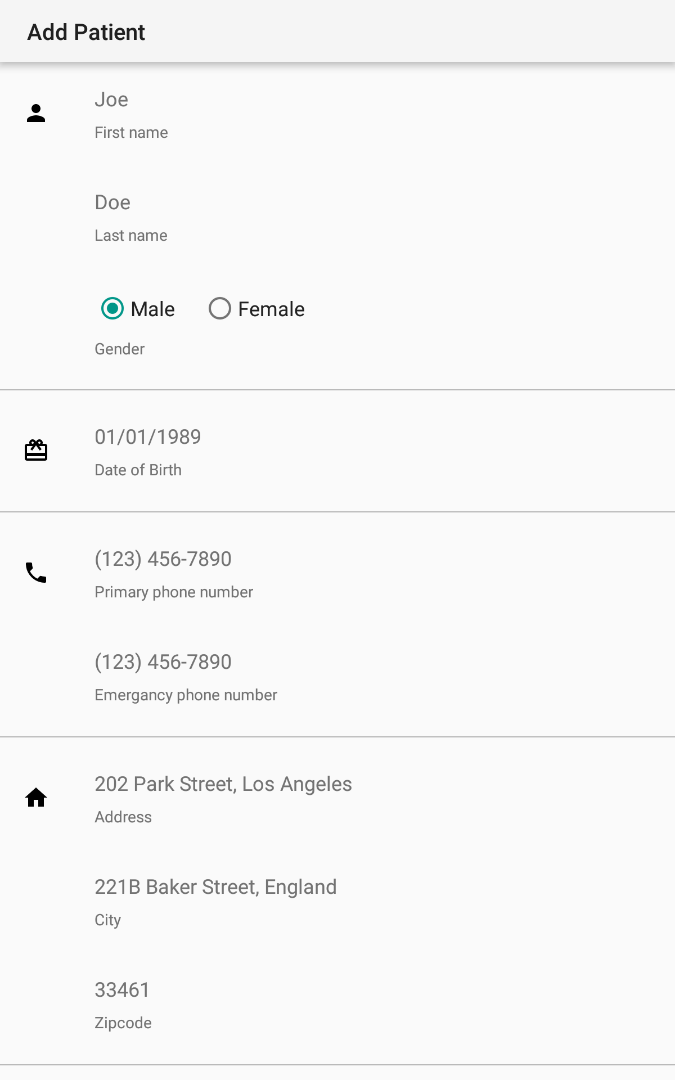
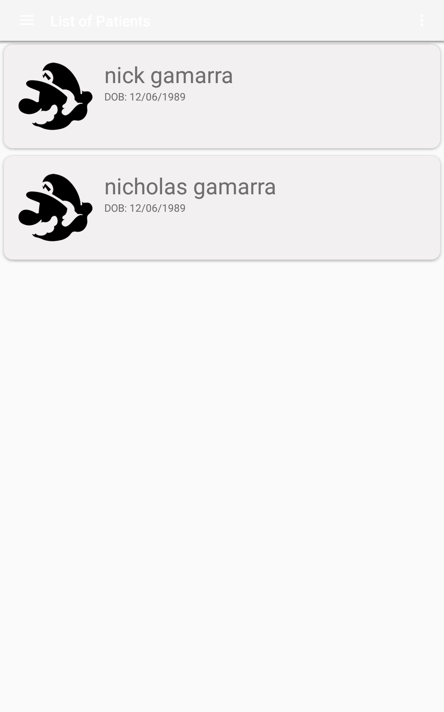
Add Patient/Existing Patient
On the left you can see the add patient screen we have implemented, requiring information such as name, gender, address, DOB, and phone number. On the right is the display of the existing patients when you are logged in as a primary caretaker. Clicking a patient will take you to their specific patient home screen.

Slide 6
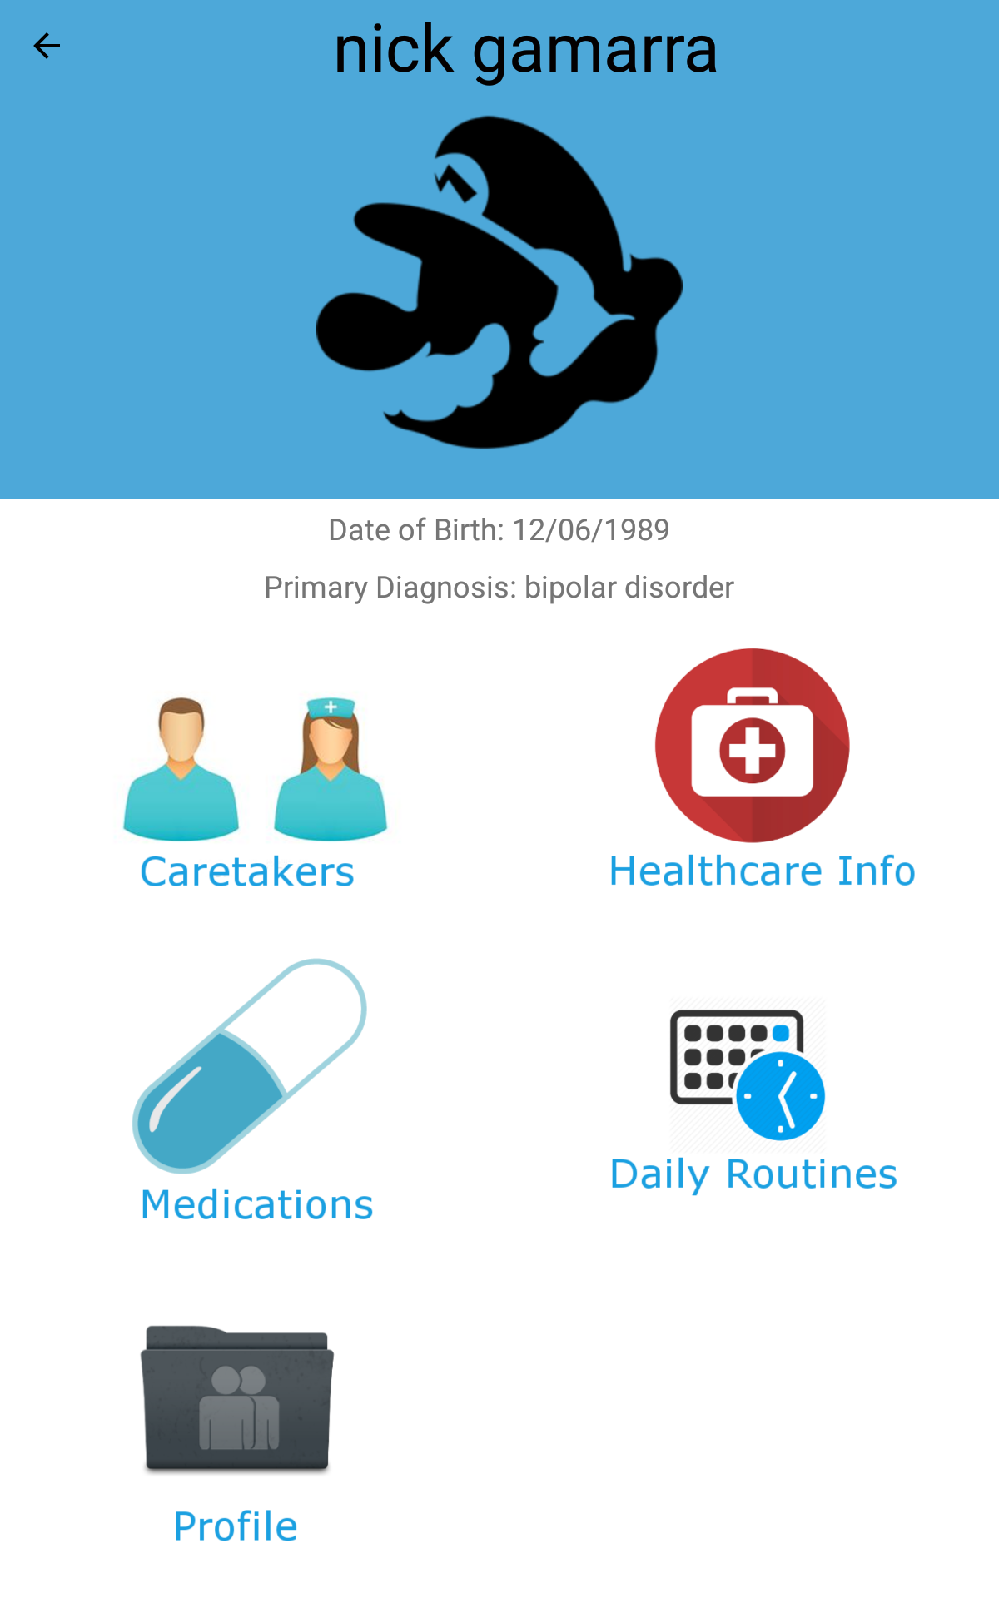
Patient Home Screen
Here you see the patient home screen when logged in as the primary caregiver. After clicking a specific patient it takes you here with all the patients pertinent information. You are able to see a list of their caregiver (assistant caregiver), healthcare information, medications, daily routines and the patient’s profile.

Slide 7
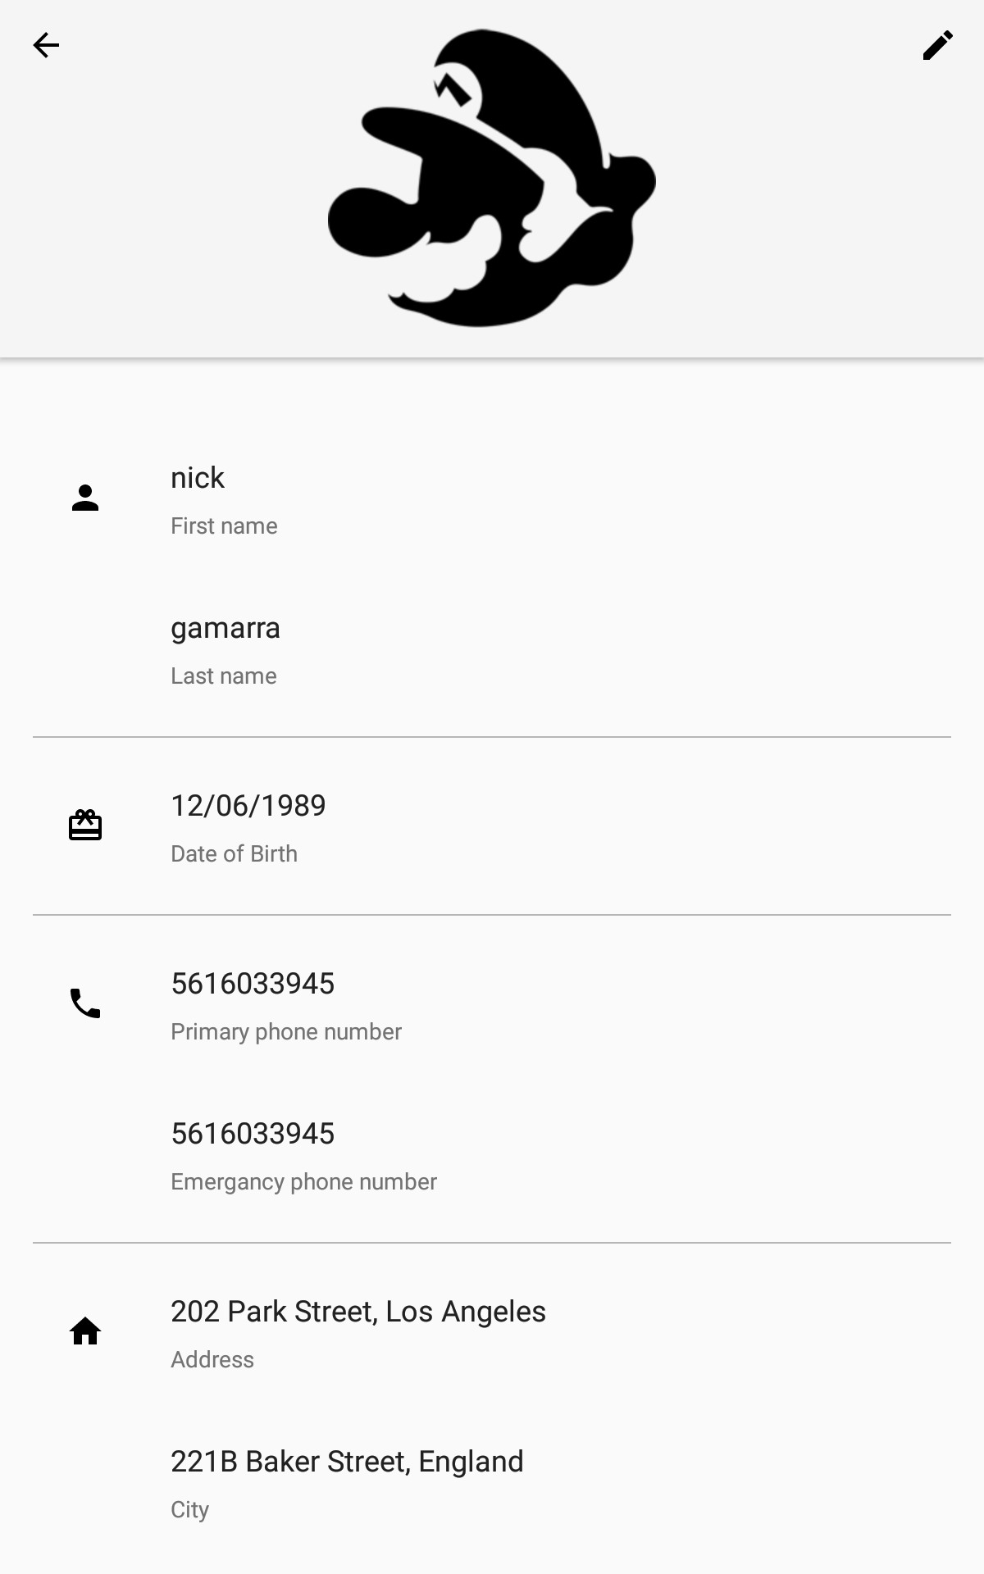
Patient Profile Page
Here is the patient profile page, which displays all the patient’s necessary information. This will be the same information requested when on the “add patient” page.

Slide 8
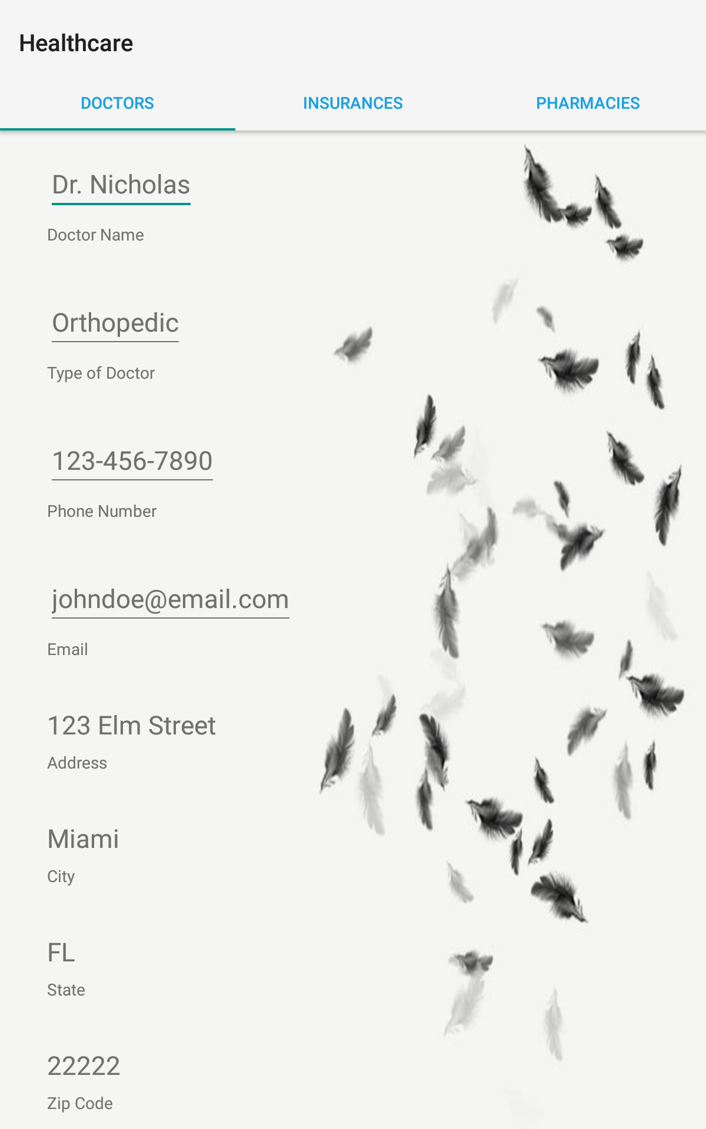
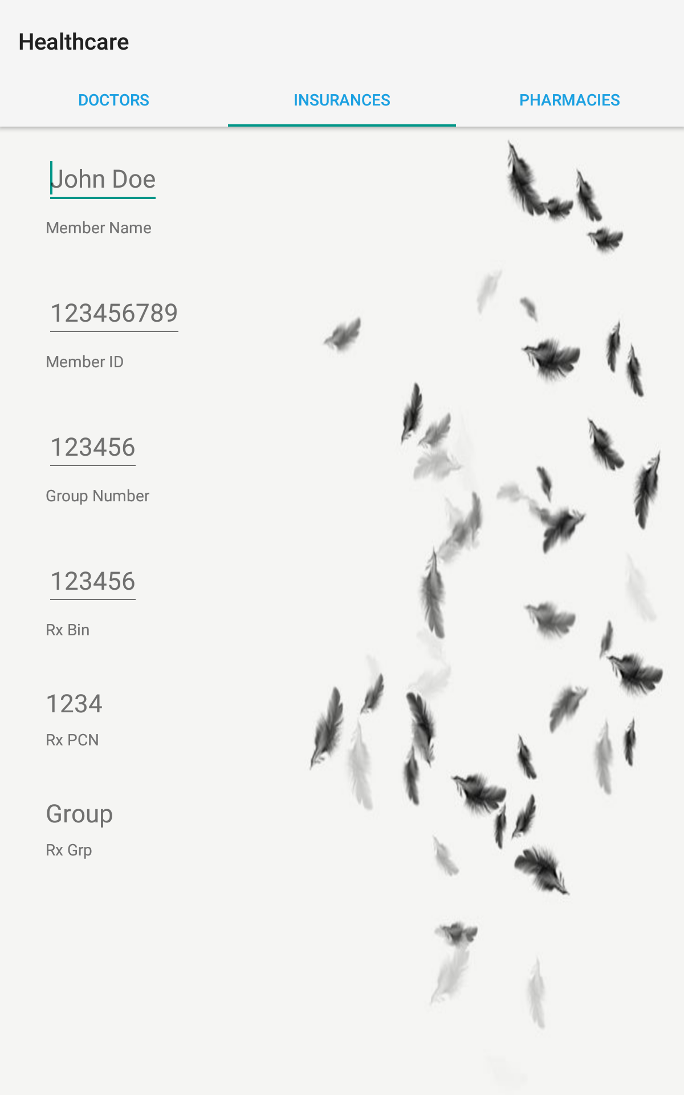
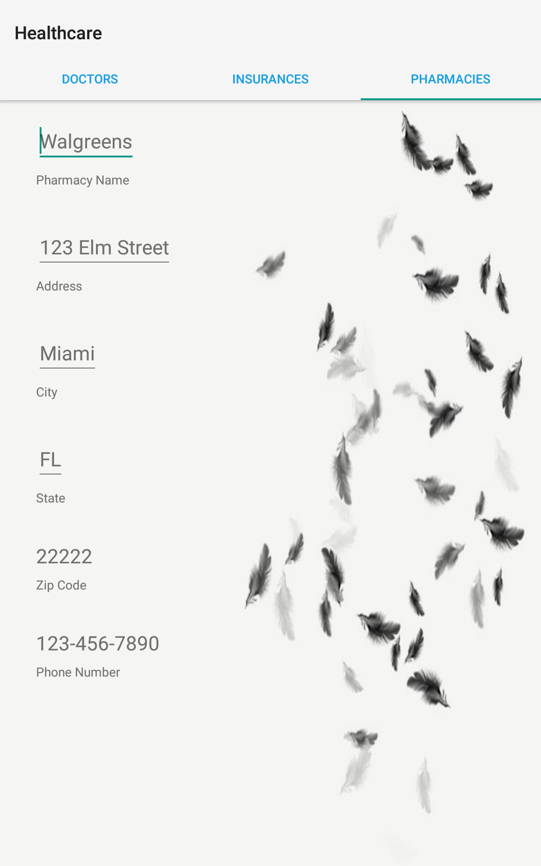
HealthCare Information

Slide 9
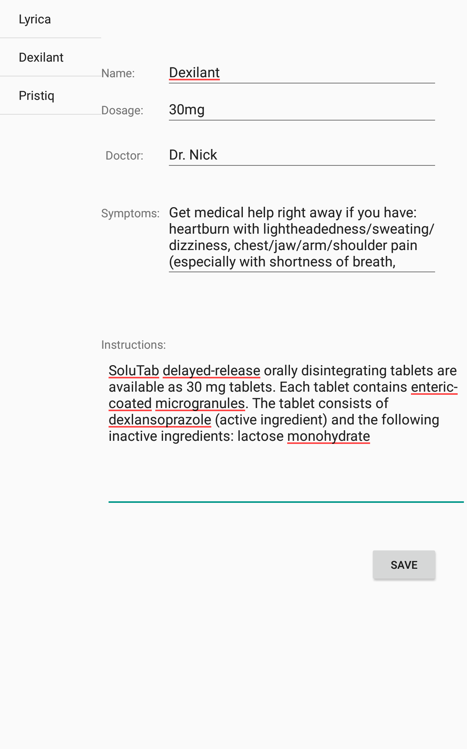
Medications Page
Here is the patient’s medication page, located through the patient’s home page. You are able to store all the patient’s medications and prescriptions along with the dosage, doctor that issued it, symptoms or side effects of the drug, as well as instructions on how and when to administer it.

Slide 10
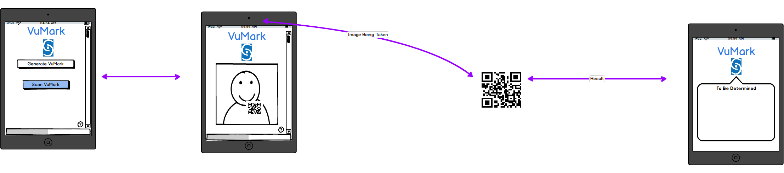
Augmented Reality
Each patient will be emailed a unique QR code that holds their ID Number. When scanned, you can:
Link to the patient upon approval
Display patient info
Scan prescription bottle with QR Code on it and view medication information

Slide 11
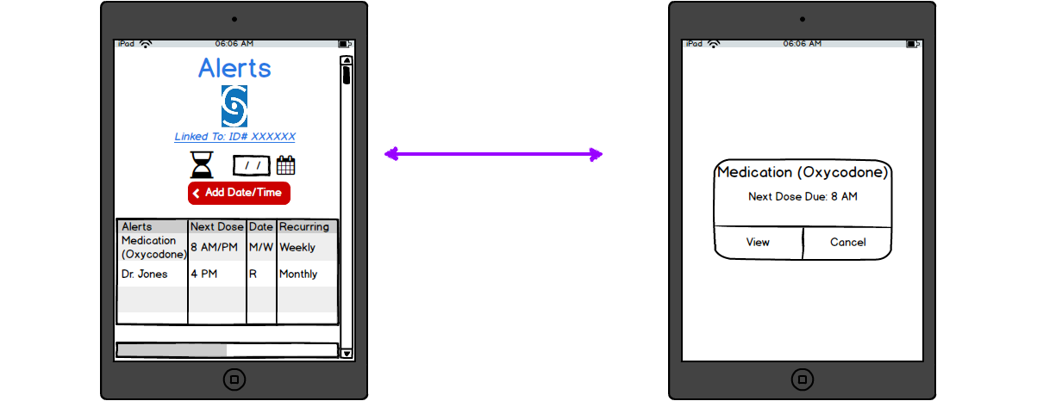
Alerts
The alerts will be able to be set any time for any specific request. Whether that is taking a certain medication, or remembering a doctors appointment, anything one deems applicable and necessary.

Slide 12
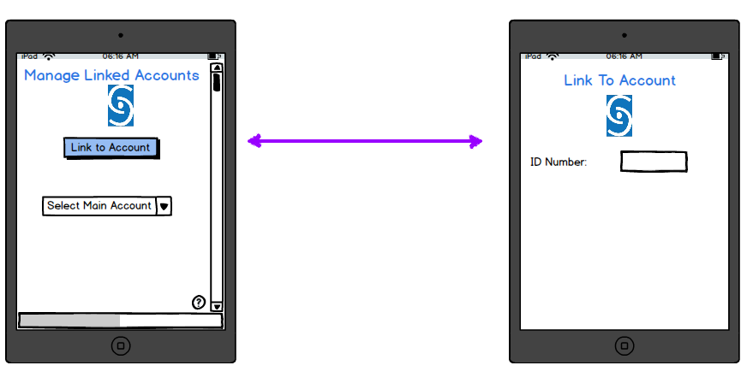
Managed Linked Patients
In this tab you, an assistant caregiver, will be able to request which patient you want to view the information for by entering the ID Number for a specific patient.

